Slide 1
To-Do List Application with Python, OOP, and Data Visualization
Using Python, Object-Oriented Programming (OOP), and Matplotlib for Visualization
Presented by : ASHISH KUMAR(246102002)

Slide 2
CONTENT:
Introduction
Project overview
Class structure
Task class
To do list class
User interface
Data visualization

Slide 3
Introduction
Objective:
To create a task management application (To-Do List) that allows users to:
Add, delete, and mark tasks as complete/incomplete.
Visualize task completion status with a pie chart.
Tools and Libraries Used:
Python, Matplotlib, Object-Oriented Programming (OOP) principles

Slide 4
Project Overview
Features:
Add and delete tasks.
Mark tasks as complete/incomplete.
Display all tasks with their completion status.
Generate a pie chart of completed vs. incomplete tasks.
Programming Concepts:
OOP (Classes, Methods)
Data visualization with Matplotlib

Slide 5
Class Structure
Classes
Task Class: Represents an individual task.
To Do List Class: Manages a list of Task objects and provides functionalities like adding,
deleting, and marking tasks complete.
Explanation:
Each task has properties: title and is completed.
To Do List class manages all Task objects and tracks their status.

Slide 6
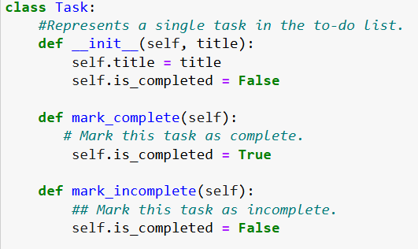
Code: Task Class
Code Snippet:
Explanation:
Initializes each task with a title.
Marks tasks as complete or incomplete.
Purpose:
Simplifies task creation and state management.

Slide 7
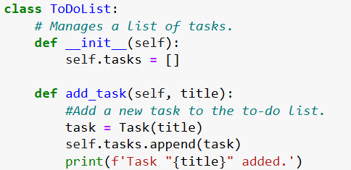
To Do List Class
Code Snippet:
Explanation:
Initializes a list to hold tasks.
Has methods for adding, deleting, marking complete, and displaying tasks.

Slide 8
User Interface in Code
Methods:
display_tasks(): Displays each task with a check or cross.
add_task(), delete_task(), mark_task_complete(): Modifies tasks.
Explanation:
User interacts with these methods in the console.

Slide 9
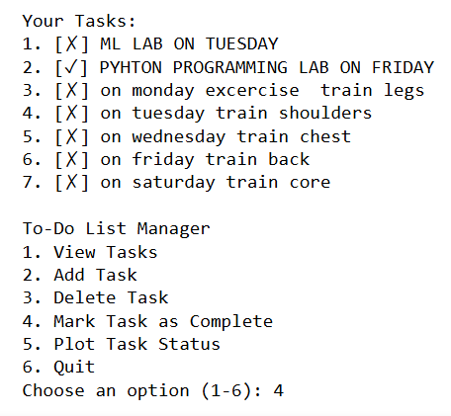
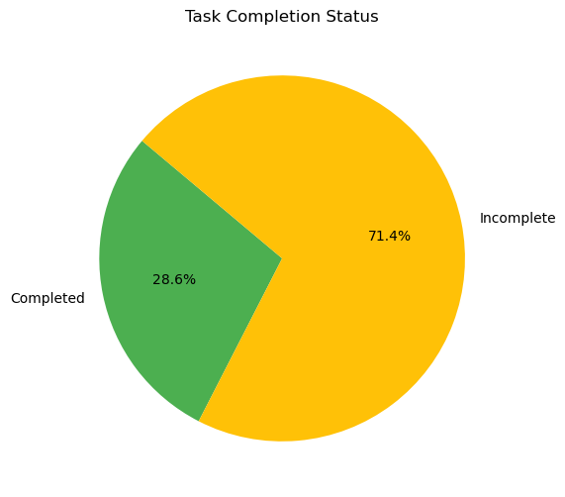
Data Visualization
Pie Chart with Matplotlib:
Generating a pie chart to show completed vs. incomplete tasks.(Plot showing the percentage of tasks completed and incompleted.)

Slide 10
Thank You

